Slide 1
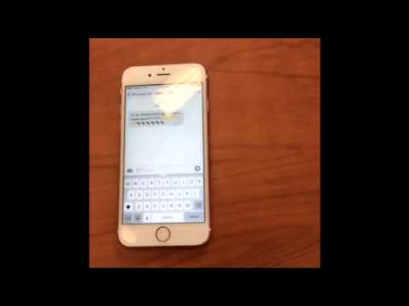

Slide 2
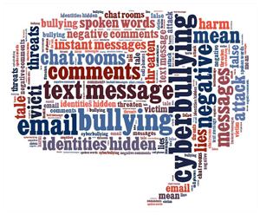
CyberBullying
By: Haylie, Maddi, Colten, Payton, Kaci, Ariana,and Jess

Slide 3

Objectives
5.3-Identify the characteristics and consequences of cyberbullying
5.5- Investigate the risks and practice safe, legal,ethical and responsible use of technology and the internet
5.6- create strong passwords,learn strategies to avoid scams and schemes, and analyze privacy policies.
5.7-Recognize and explain the need for protecting privacy in order to preserve an online digital footprint.

Slide 4

What is cyberbullying?
Cyberbullying is using electronics to bully a person. This is usually done by sending a message or picture of an embarrassing or threatening object.
The problem is created by the fact that a bully can hide behind an electronic device, disguising his/her true identity, thinking they can not get caught.
The thought of not having a true identity makes the bully want to say more hurtful things to the directed person.
Although it is difficult to trace the cyberbully, anything is possible, so you can always get caught.

Slide 5

what is the difference between cyberbullying and traditional bullying
The victim of cyberbullying typically does not know who did it.
The conversation can go viral on the web within minutes.
When online, the whole conversation can be traced from beginning to end.
Cyberbullying is done from a distance and the bully doesn't have to see the victim to hurt them.
Parents and adults do not have the technical abilities to respond or monitor what has happened.

Slide 6
Types of cyberbullying
Flaming-Online fights done usually my email or group chats. This is where angry or rude comments are said to one another resulting in cyberbullying. Denigration- Putting mean messages on social media or in group chats to hurt somebody and make them feel worthless Exclusion-Leaving someone out of a group activity on purpose, because you want to make fun of them Outing-Sharing personal information about someone that they didn't want to get out Trickery-Tricking someone into sharing personal information then sharing it online Impersonation-Pretending to be someone else while spreading mean and false messages Harassment-Constantly sending mean messages to someone online after being asked to stop Cyberstalking-Continuously harassing others using threats of physical harm.

Slide 7
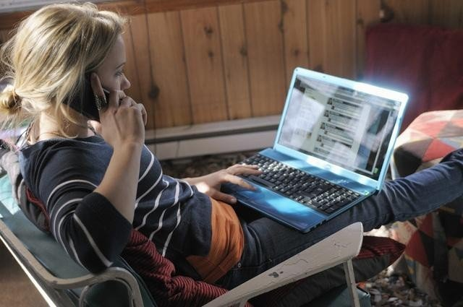
who is usually the cyberbully?
Usually someone who is popular and has been bullied (retaliation bully)
Someone who seeks attention. (Power hungry bully)
Someone who bullies for entertainment or out of boredom (Mean girl)
Seeks revenge for someone else that has been bullied (Vengeful Angel)
Uses the internet carelessly but does not want to do any harm (Inadvertent cyberbully)

Slide 8

Why people Cyberbully
To stay or get popular
To feel powerful
They have low self-esteem
They believe the victim deserves it
They want to get rid of their boredom
They lack empathy
They don't think they will get caught
They are stressed
They think they are better than others

Slide 9
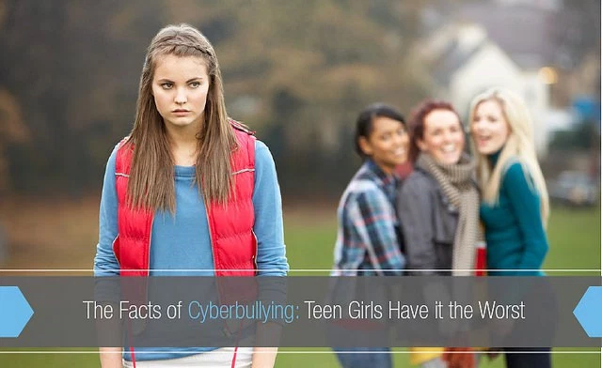
BOYS VS. GIRLS
Girls tend to be more involved in cyberbullying on social media and text messages. Girls are about twice as likely as boys to be victims and perpetrators of cyberbullying.
Boys are more involved in gaming and use chatrooms to hurt people using a more violent language.

Slide 10

Personal Relations
Harassment in the meaning of ¨flirting¨
Name calling in the meaning of ¨flirting¨
Breakups. So they feel the need to bully
Online fights about relationships

Slide 11
RECOGNITION
School officials must recognize that what initially appears to be an online threat could be any of the following:
A joke, parody, or game
A false rumor that was started
Items that were posted by someone impersonating another person to get that person in trouble
stressful material posted by a depressed or angry teen that could start a violent or suicidal intention, but does not represent an immediate threat

Slide 12
RECOGNITION
Students must understand the following:
Don’t make threats online – Most adults won't be able to tell if the threat is real or just a joke. Students must understand that they can be costing someone's life. They could get suspended, expelled, or even arrested
Report threats or distressing material – If students see a threat online, they need to immediately report it to an adult. It is very important to report this to an adult because if not, someone could be seriously injured.

Slide 13
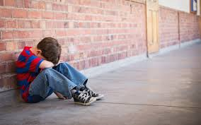

The Impact of Cyberbullying
The victim can have low self- esteem.
They may become depressed.
They may start using alcohol and drugs.
Increased risk for suicidal thoughts.
This can leave a lifelong effect on the cyberbully victim.
They can possibly start to think about committing suicide or successfully do it.

Slide 14
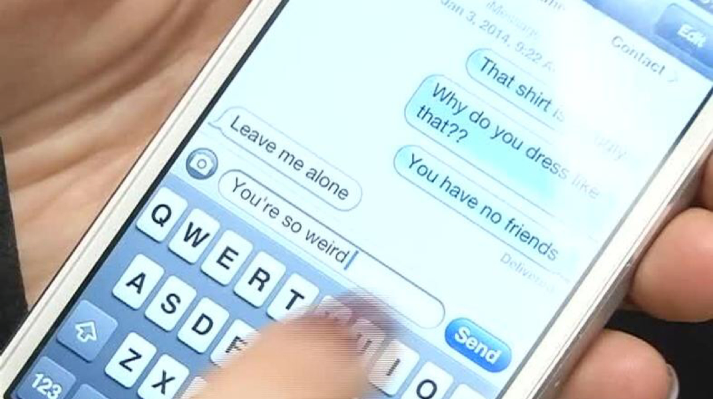
Warning signs of a victim
Suddenly stops using computer or cell phone
Nervous or jumpy when notifications appear
Scared to go to school
Always looks angry, depressed or frustrated after using computer or cell phone
Avoids discussions about what they are doing on computer or cell phone
Detaches themselves from their friends

Slide 15
Warning signs of a bully
Quickly switches screens or closes tabs.
Gets unusually upset if computer or phone are taken away.
Avoids discussions about what they are doing on electronics
Appears to be using multiple accounts or ones not their own.

Slide 16

Cyberbullying turning into Physical bullying
Sometimes when people cyberbully, they turn it into more by asking to meet you somewhere or runaway from home to be with them. They manipulate you just to get to you in any way possible.
When they ask to meet up with you and you go through with the plan, they ask to meet you somewhere and then they will drive you away. Sometimes they don’t drive you away.
If you do accept to go with them or meet up with them they could really hurt you and possibly kill you.
If you get cyber bullied make sure that you report it, and never fall through with anything.

Slide 17

Safe Passwords
You can use a website called Strong Random Password Generator to have more secure passwords.http://passwordsgenerator.net/. Never use a family member or a pet’s name Some of the safest passwords that you can use are:
g/U9b$
bTu3/5
Ht7wwe Some Easy Passwords are:
1234,
4321,
abc123

Slide 18

Reporting cyberbullying
If someone has been cyberbullying you should report them to whatever website they are bullying you on. For an example, if someone is bullying you on Facebook, there is a report button on the messages or you can go on their page and there is a report button. You click it and it will report the user to the Facebook Company. If you are texting follow the steps below;
Keep the evidence
Record the time and date it happened
Tell an adult you trust
Report the evidence

Slide 19
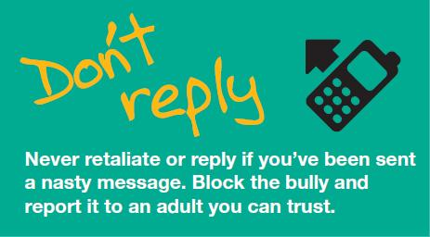
How to respond to cyber bullies
First thing just ignore them, don’t even fight back with them
Don’t let them keep bullying you
Tell them to stop. If they don’t then immediately report them
Save the evidence, don’t erase anything at all
Block the person who is bullying you
Report them to the content provider

Slide 20
How many kids get cyber bullied
More than ⅓ of elementary students get bullied
More than 25% of teens and adolescents report getting bullied
Over 80% of teens use cell phones daily
Over half of the kids that get cyber bullied do not report it
43% of kids younger than 12 get cyber bullied
52% of teens get cyberbullied
¼ kids have been cyber bullied more than once
Only ⅙ parents say they know if their child is getting cyberbullied
Between 10% and 20% of children report getting cyberbullied every day
95% of teens that have witness cyberbullying online do not report it

Slide 21
What to who to talk to about do if
you’re getting cyberbullied
Talk to an adult or parent you trust
Tell a friend
Report it to the police
Call a cyberbully hotline (1-800-420-1479)

Slide 22
